Slide 1
Kyle Muldoon
Jasraj Dhudwal
Alex Lambert

Slide 2


Slide 3
Data = SONGS
This Application WIll Provide a sorted Database of the top songs in the world ranked by popularity.

Slide 4

SONG
Attributes:
Name
Artist
Position

Slide 5
Features
Add
Delete
Search
By Title
By Artist
By Position
Print
Key Sequence
HashTable
Indented Tree
Play Song

Slide 6
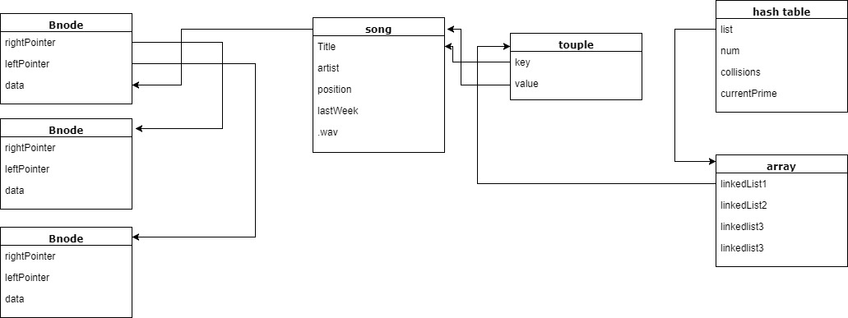
Diagrams and Structures

Slide 7
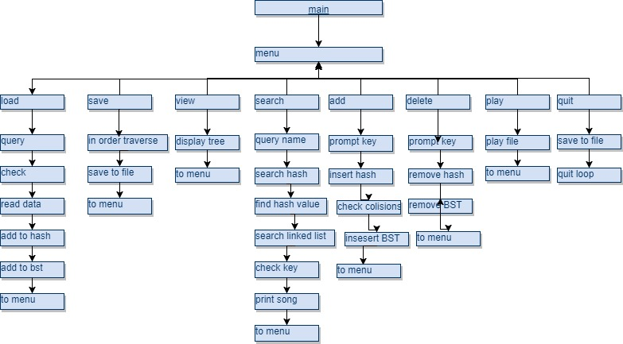
Diagrams and Structures cont.

Slide 8
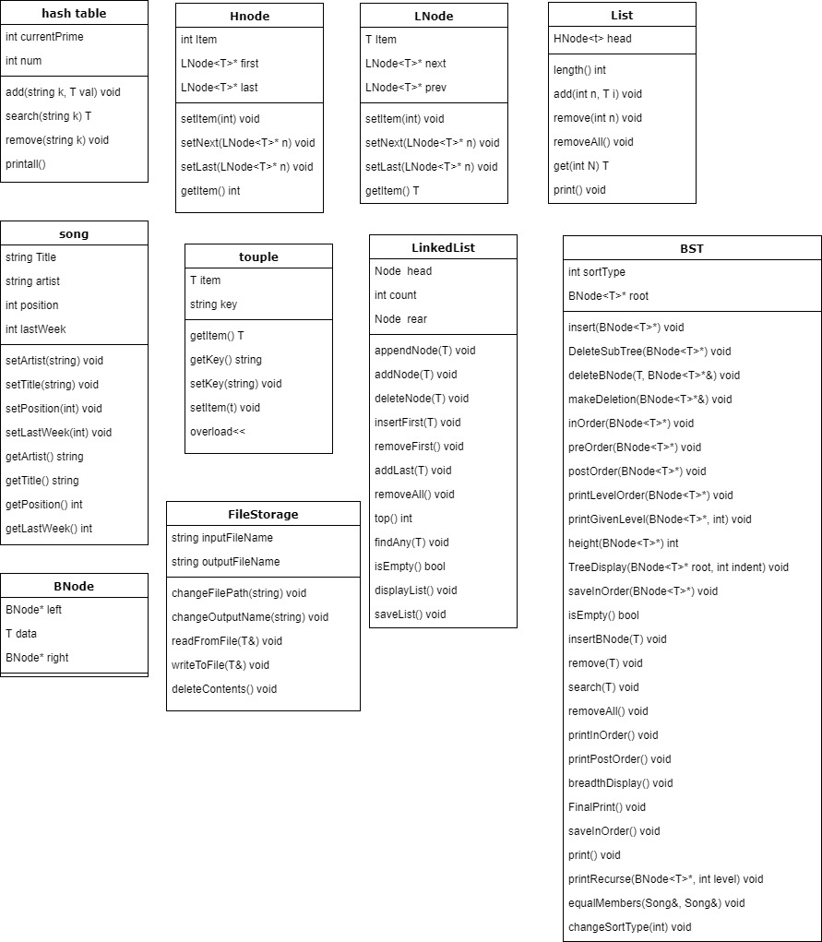
UUMLM

Slide 9
collisions
store total collisions
Store number of collisions that are insolvable
Difference is solvable collisions
If difference exceeds x increase to next prime and repopulate

Slide 10
Hash function
int num = 0;
//adds the asci values of each char to num
for (int i = 0; i < k.length(); i++)
{
char x = k.at(i);
int n = int(x);
num += int(x);
}
//makes num less then current prime(so its a valid index)
num = num % currentPrime;
//returns num
return num;

Slide 11
DEMO

